Slide 1
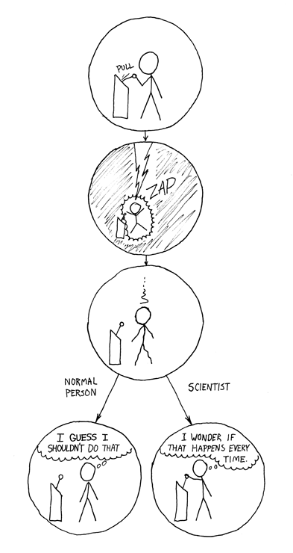
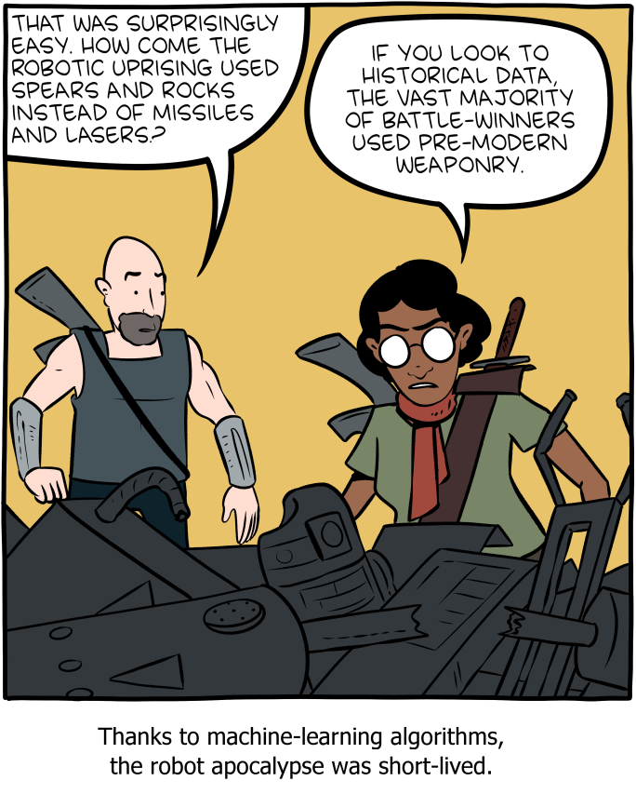
Notes:
Done

Slide 2
CIS 700-004: Lecture 11M
Reinforcement Learning, Part I
3/25/19
Notes:
Done

Slide 3
What is reinforcement learning?
Notes:
Done

Slide 4
Reinforcement learning (RL)
Get a (positive) reward when you do something right
Negative reward if something wrong
No explicit description of what the right/wrong thing was
Sometimes a time delay
Notes:
Done

Slide 5
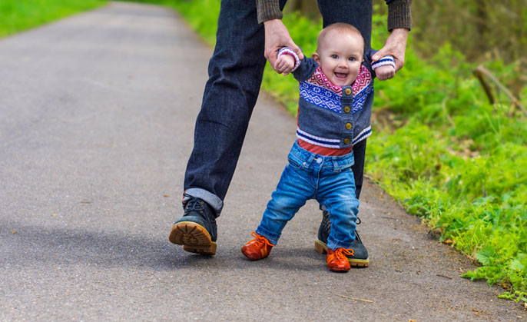



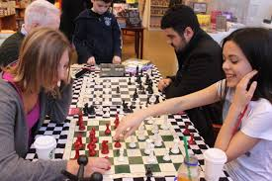

Notes:
Done

Slide 6
Terminology
An agent (e.g. player) takes actions in an environment (e.g. a game).
The environment has states (e.g. board positions).
For each pair (state, action), the environment give the agent a reward (e.g. points)
After some (possibly variable) number of states, the episode ends (e.g. game over).
Learning proceeds for many episodes.
The goal of the agent is to maximize expected reward.
Notes:
Done

Slide 7
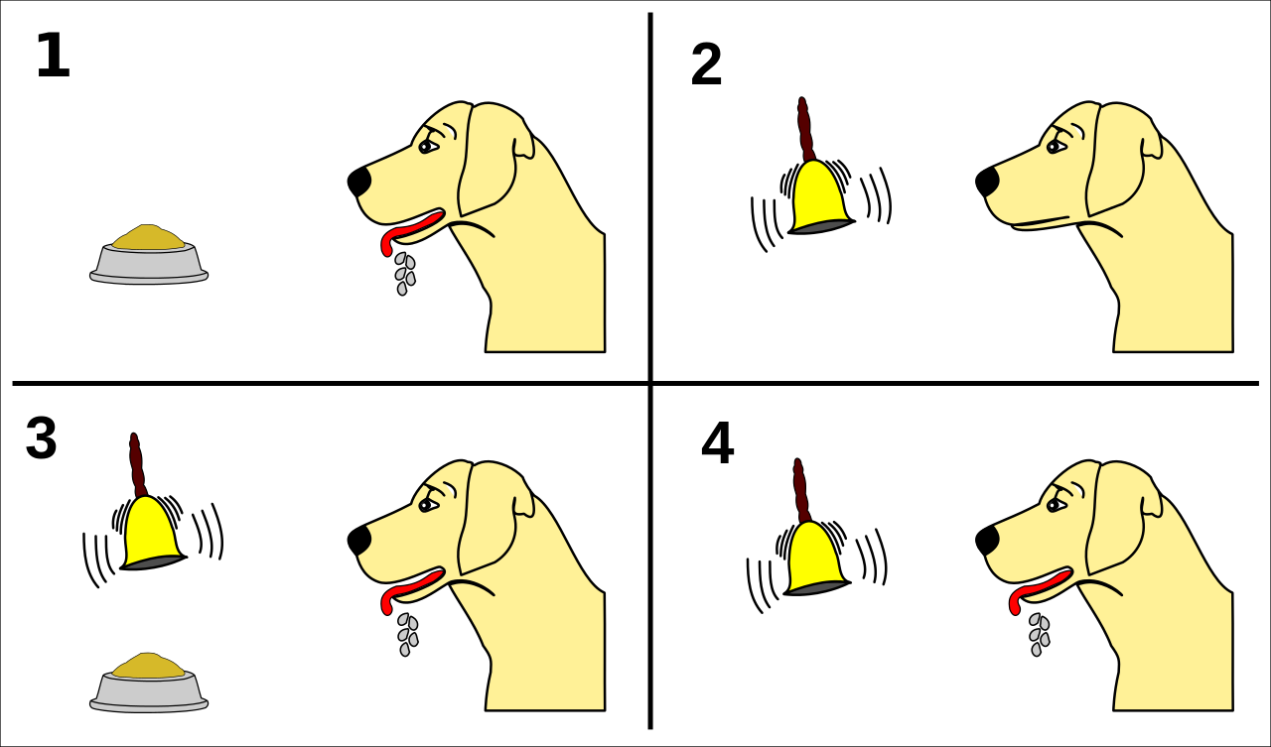
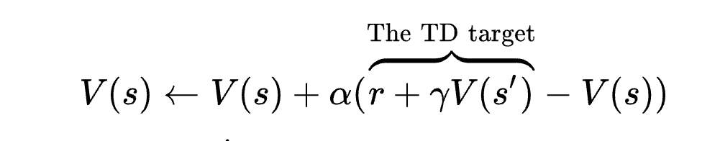
RL in behavior: trivial pavlov
Notes:
Done

Slide 8
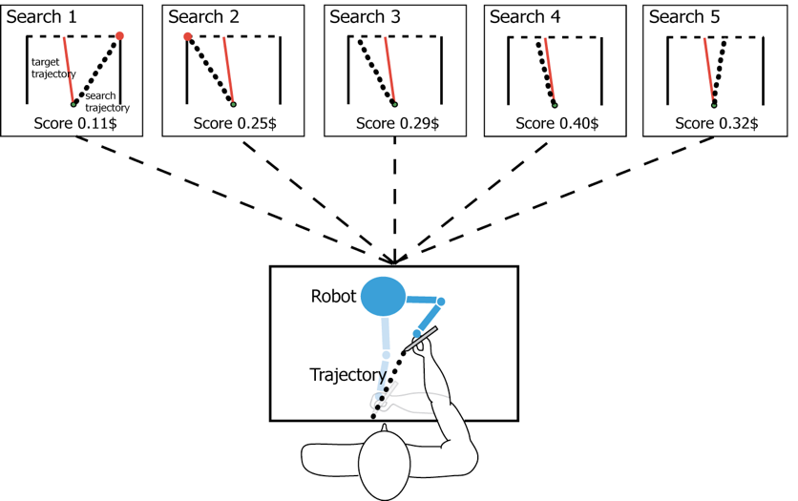
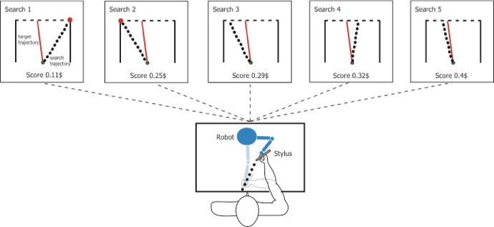
RL by people
Dam and Kording 2008
Notes:
Done

Slide 9
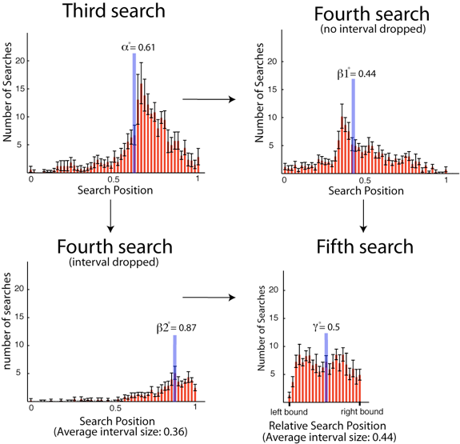
Pretty good behavior
Notes:
Done

Slide 10
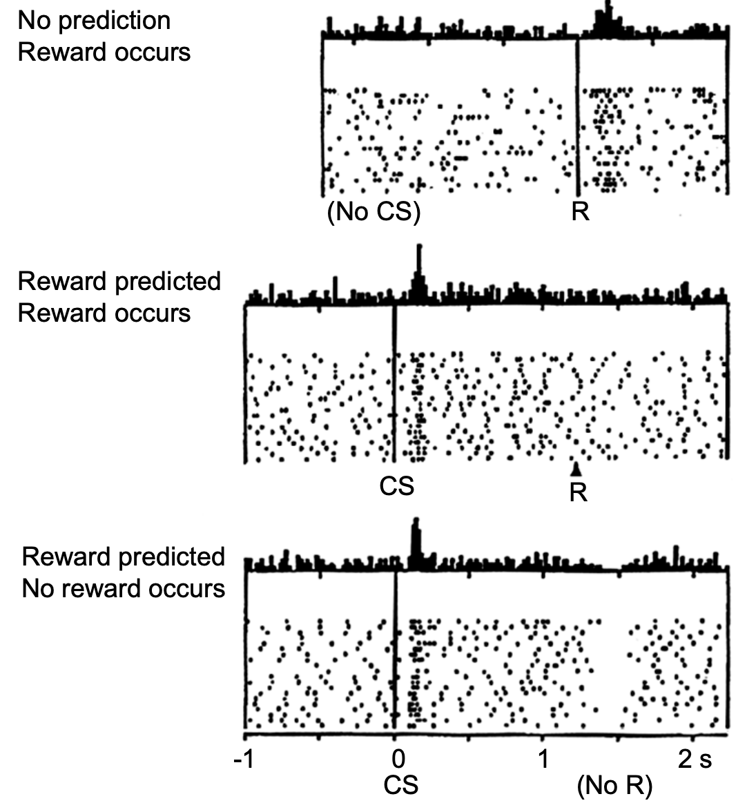
Neural evidence for knowing value of state
Schultz, Dayan, Montague, 1997
Notes:
Done

Slide 11
Q-learning
Notes:
Done

Slide 12
What is a Q-value?
Function Q(s, a) from (state, action) pairs to real numbers.
Optimal function Q* gives maximal possible reward from the state given the action:
The maximum is over possible future actions that can be taken.
We want to pick Q close to Q*.
The value 𝛾 (gamma) is called a discount factor, helps learning.
Often picked to be close to 1, like 0.99.
Notes:
Done

Slide 13
Updating Q-values
We want:
We can update each value Q(s,a) separately according to the rule:
Intuitively, this means we push it in the direction where it made a mistake.
Notes:
Done

Slide 14
Convergence of Q-learning
Converges to opt Q* if visit each (state, action) pair some large number of times.
The bounds are pretty terrible (like MCMC).
In practice, no-one ever runs for that long.
But also in practice, it works pretty well.
Notes:
Done

Slide 15
Model-free vs. model-based RL
Q-learning learns each Q-value separately - essentially a big table.
No savings from patterns.
In many cases, transitions can be modeled.
If know all transitions, dynamic programming can sometimes solve an RL problem.
Notes:
Done

Slide 16
Policy gradient methods
Notes:
Done

Slide 17
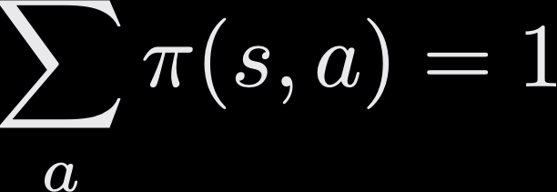
What is a policy?
Given many possible actions, which should one pick?
Formally, a (stochastic) policy is a function 𝝅(s, a) on state-action pairs such that:
Notes:
Done

Slide 18
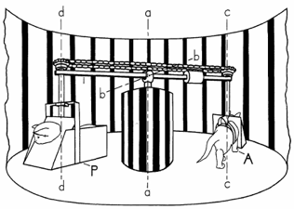
Off-policy vs. on-policy learning
On-policy learning means the agent can choose actions.
Off-policy learning means actions are chosen for the agent. This is harder.
Held & Hein (1963) experiments with kittens.
Notes:
Done

Slide 19
Off-policy vs. on-policy learning
Is Q-learning off- or on-policy?
It’s generally off-policy.
Often people take a greedy approach: action maximizing estimated Q-value.
What’s the (potential) problem with this?
That might mean not all (state, action) pairs are explored.
Then Q-learning might not converge.
Notes:
Done

Slide 20
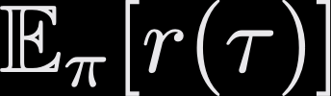
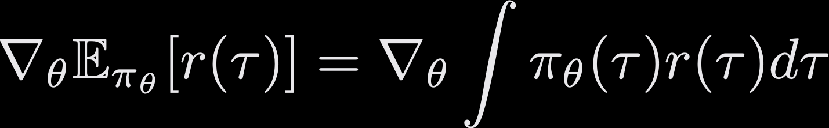
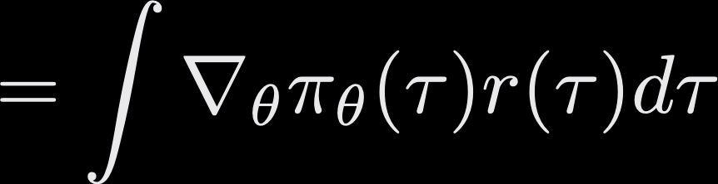
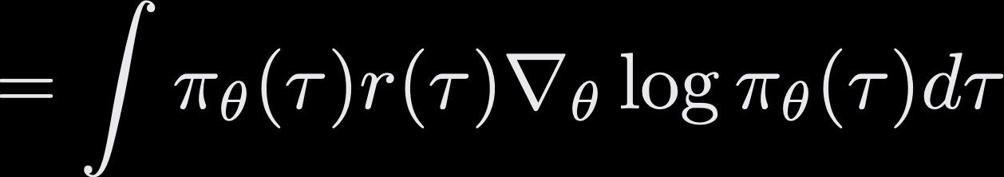
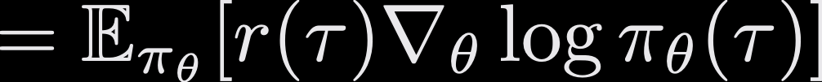
Policy gradient
Goal of a policy 𝜋: maximize the total expected reward over the entire trajectory 𝜏
Gradient descent on the parameters 𝜽:
Notes:
Done

Slide 21
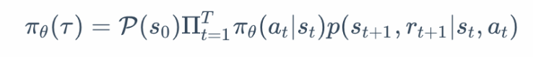
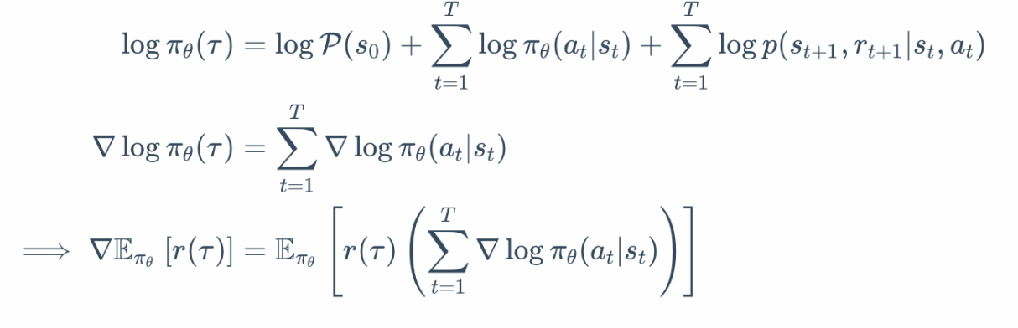
Policy gradient
Let’s expand over the trajectory 𝜏
Notes:
Done

Slide 22
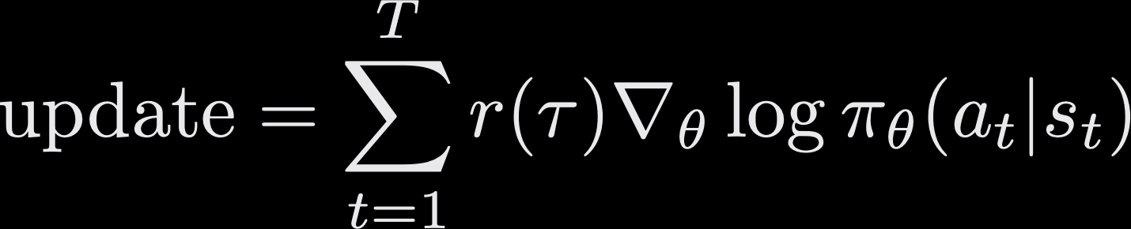
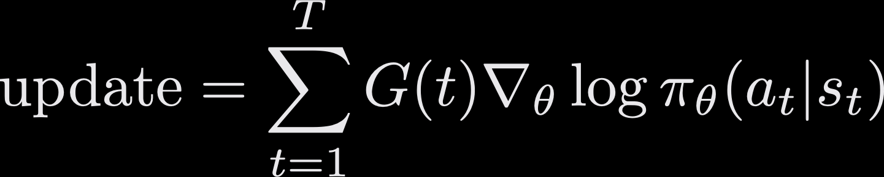
Policy gradient
That means can estimate the policy gradient by sampling trajectories and computing:
We actually don’t have to use the whole trajectory reward.
Only future rewards are affected by the action.
Natural to add discounts to rewards further in the future.
Notes:
Done

Slide 23
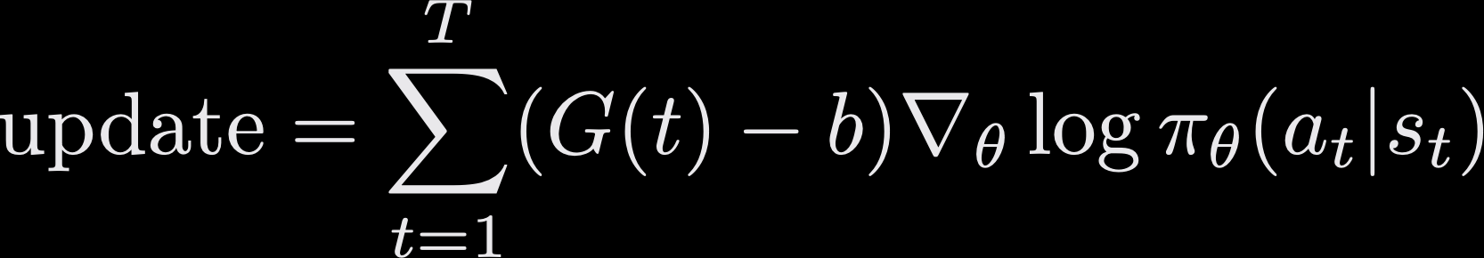
Policy gradient
This is called the REINFORCE algorithm.
There is a simple trick that reduces the variance of the estimator:
The value b is called a baseline, and is just a constant.
Notes:
Done

Slide 24
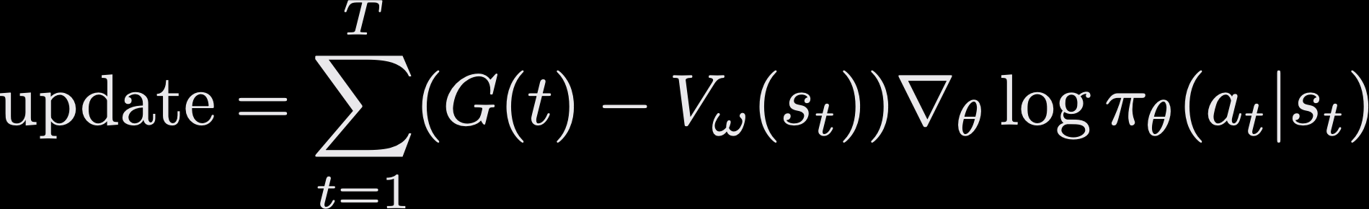
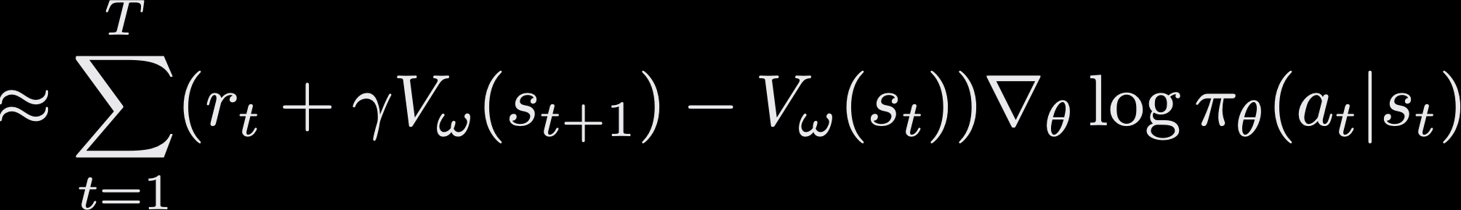
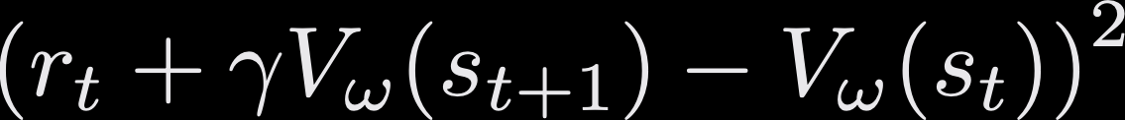
Actor-critic
We can also learn the baseline!
This V function (called a value function) is learned with L2 loss:
Two functions to update: policy and value networks.
Notes:
Done

Slide 25
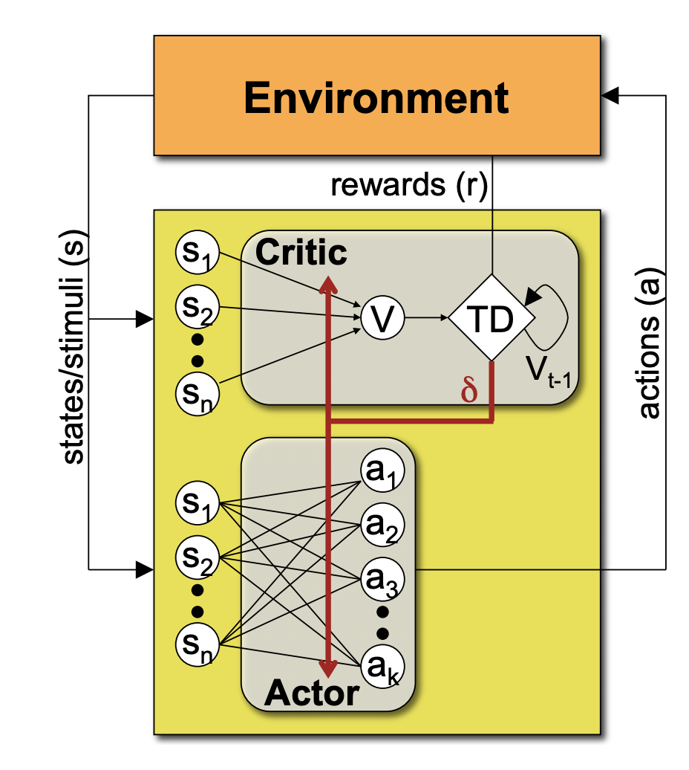
Actor-critic
Notes:
Done

Slide 26
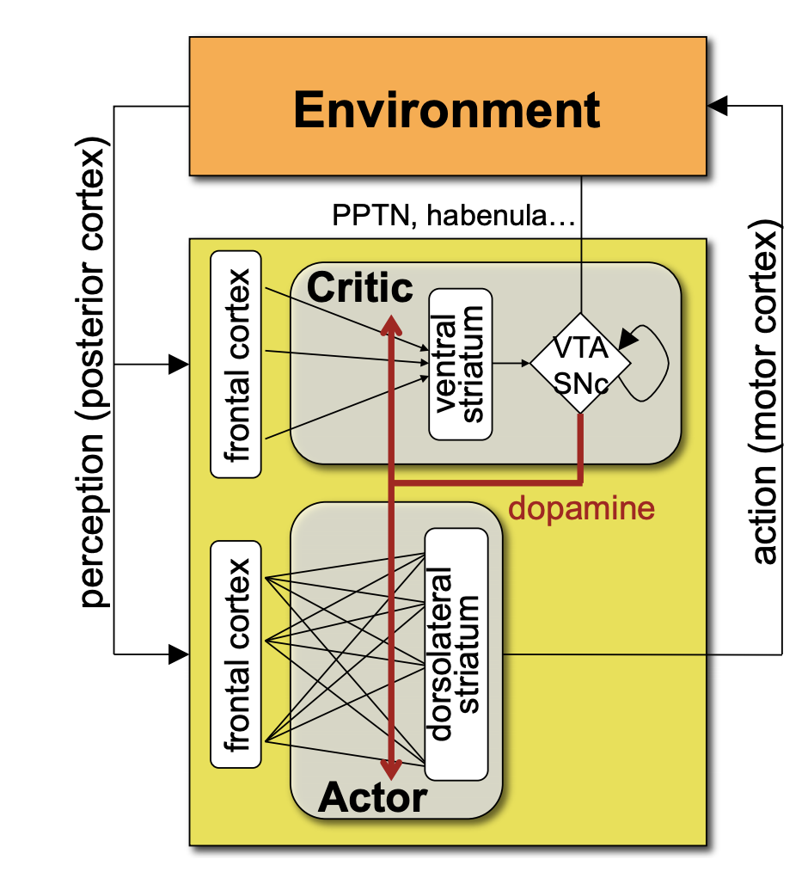
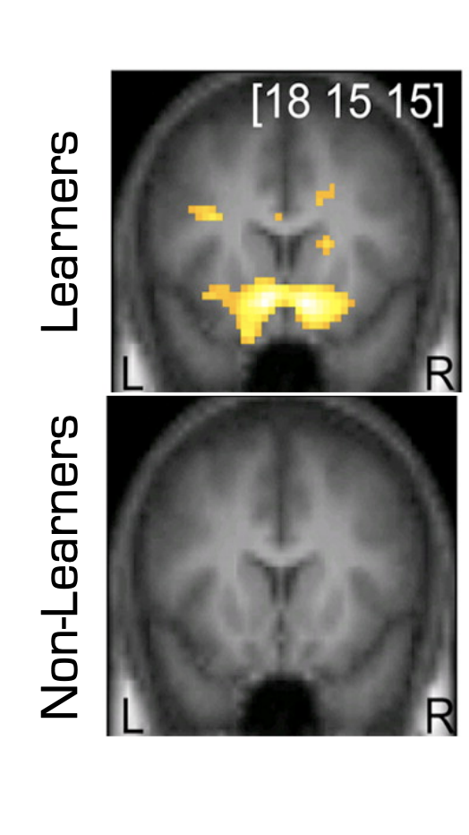
Actor critique in the brain
Yael Niv
Notes:
Done

Slide 27
Deep RL
Notes:
Done

Slide 28
The credit assignment problem
Suppose an agent’s actions are predicted by a neural network.
How does the network learn?
There are no labels for “right” and “wrong” actions.
What parts of the network are responsible for good/bad rewards?
Notes:
Done

Slide 29
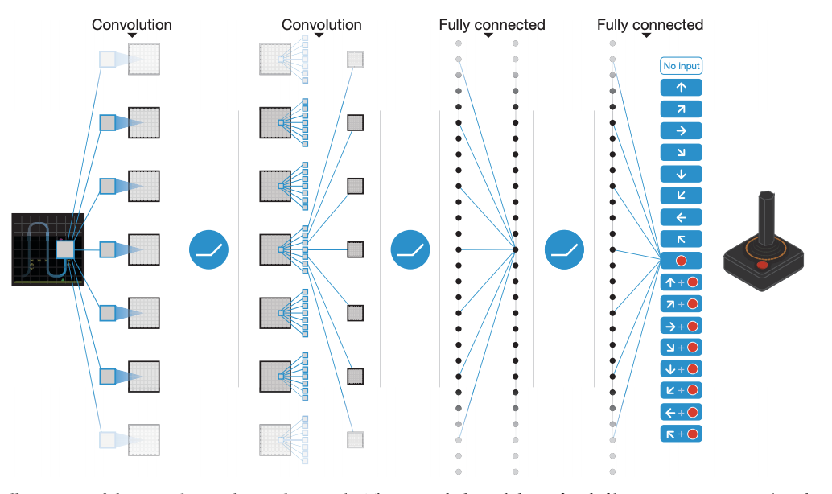
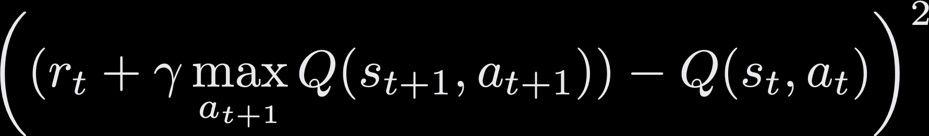
Deep Q learning (DQN)
Predict Q-values, instead of actions.
Input: the state
Output: Q-values for possible actions.
Learning step: gradient descent with the loss:
Policy: often by maximizing the Q-value.
Notes:
Done

Slide 30
Deep Q learning (DQN)
Distribution of actions changes over time.
Can forget stuff it learned early on (e.g. basic mistakes).
Experience replay: store past experiences = (state, action, reward, next state)
Learn from random samples from the past
Inspired by hippocampal replay in the brain
Notes:
Done

Slide 31
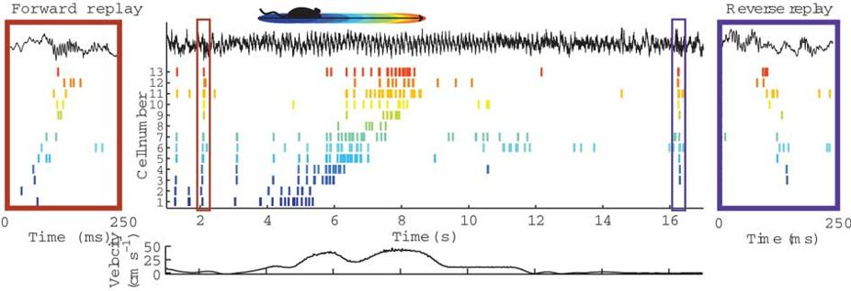
Hippocampal replay
Carr, Jadav, Frank, 2011
Notes:
Done

Slide 32
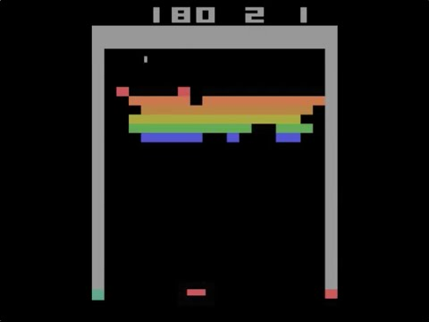
Deep Q learning (DQN)
Notes:
Done

Slide 33
Deep policy gradient
Instead of estimating the Q values with a network, estimate the policy.
Input: the state
Output: policy across possible actions
What does a policy look like? (given the state)
Probability distribution over actions.
How can we get it?
Softmax :)
Notes:
Done

Slide 34
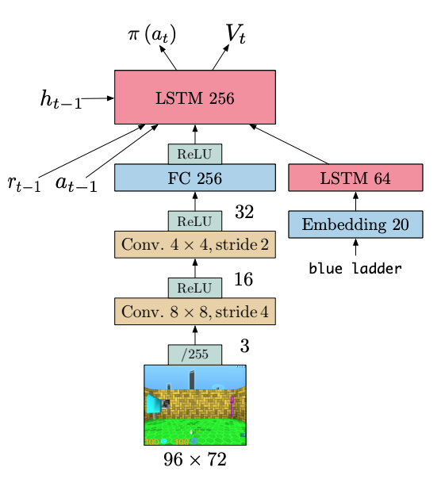
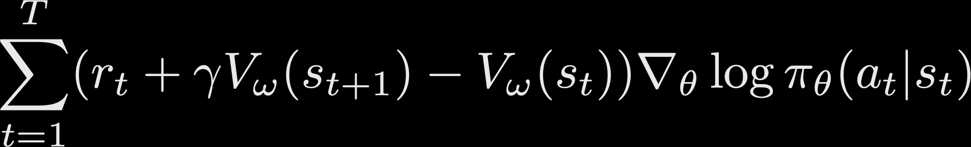
Deep policy gradient
IMPALA architecture, using actor-critic
Train the network by policy gradient:
We can also do actor-critic policy gradient.
That needs a value function prediction.
Also a neural network!
Often the two networks share the body.
Split into policy head and value head.
Notes:
Done

Slide 35
Some deep actor-critic algorithms
Often, networks use ResNets (for processing images) and LSTMs (for capturing temporal structure).
Asynchronous Advantage Actor-Critic (A3C):
Several agents act separately.
Gradient updates to shared learner.
Learner periodically updates actors.
IMPALA:
Adds importance weighting to correct for the agents getting out of sync.
Reweights the policies of agents w.r.t. learner.
Notes:
Done

Slide 36
AlphaGo
Notes:
Done

Slide 37
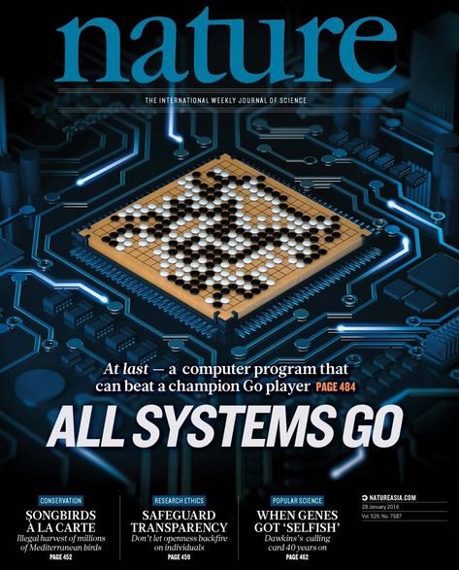
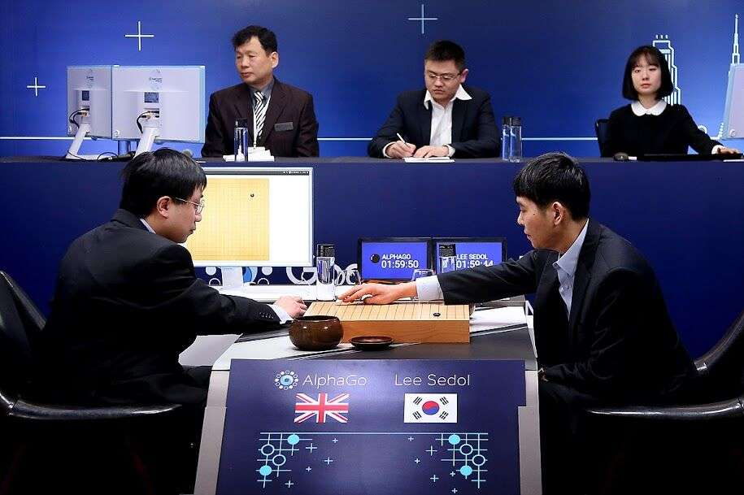
Notes:
Done

Slide 38
Why is Go hard?
Chess: ~35 possible moves, ~80 moves per game
Go: ~250 possible moves, ~150 moves per game
Too many for playing out possible games.
High intuition, widely seen as an art form.
Notes:
Done

Slide 39
Original AlphaGo algorithm
Train a ConvNet to predict (supervised learning) moves by human experts.
Use as starting point for policy gradient (self-play against older self).
Train value network with examples from policy network self-play.
Use Monte Carlo tree search to explore possible games.
Implementation notes:
Board preprocessed by labeling a few positions.
Used 30M moves by humans, 50 GPUs for 3 weeks.
Policy network: 50 GPUs for 1 day.
Value network: 50 GPUs for 1 week (30M games of self-play).
Notes:
Done

Slide 40
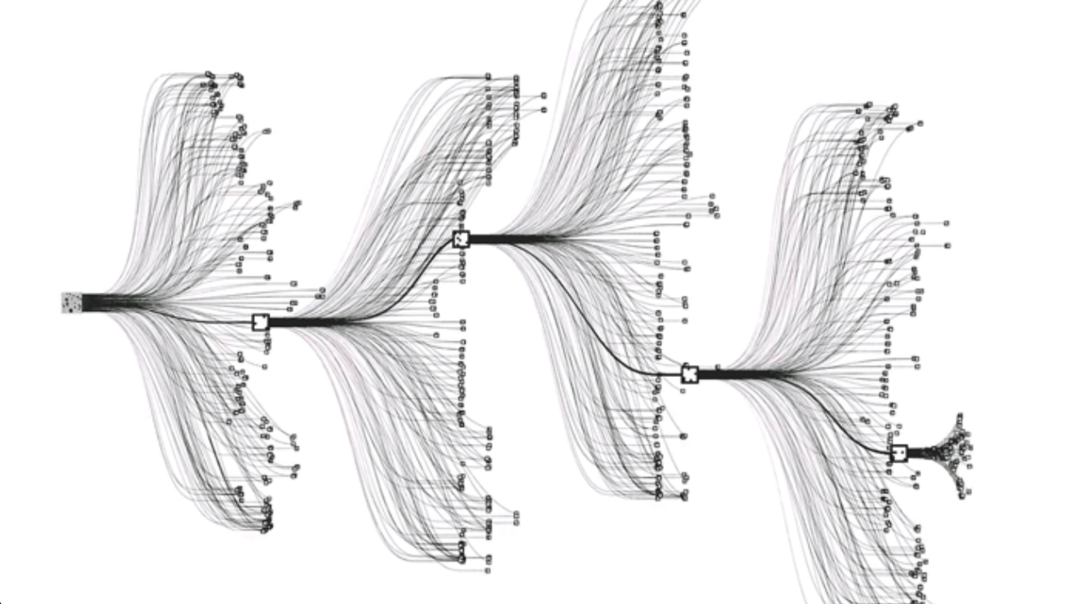
What is Monte Carlo tree search?
Imagine a tree branching into all possible moves.
Too many paths to explore.
Learned policy networks reduce the width.
Learned value networks reduce the depth.
Estimate best moves at each branch point to try.
Selection uses the supervised learning network (policy network worse at exploration).
Position after n moves scored by 1) value network, 2) Approximate playouts using a small fast network.
After many playouts, pick the best move.
Notes:
Done

Slide 41
AlphaZero
No human experience needed.
Single network instead of separate policy and value nets.
No annotated features - just the raw board position.
Trained to predict the position values estimated by Monte Carlo tree search.
Beat AlphaGo (100-0) after just 72 hours of (massively parallelized) training.
Notes:
Done

